Slide 1

KAKATIYA INSTITUTE OF TECHNOLOGY AND
SCIENCE,WARANGAL-15
DEPARTMENT OF INFORMATION TECHNOLOGY
Mini Project Presentation
on
autocomplete feature using trie
By
N.Raswitha
Roll No:B15IT053, IT
MiniProject Supervisor:-
Suma Patra
Asst.Prof
Dept.of IT
Head:-
Dr.P.Kamakshi
Professor & Head
Dept.of IT

Slide 2
CONTENTS
Objective.
Requirements.
Query Autocompletion.
Trie Data Structure.
Why Trie Data Structure?
Structure of an Trie.
Insertion in Trie Data Structure.
Search for an key in Trie Data Structure.
Auto Complete feature using Trie.

Slide 3
Objective
We should store the strings into the Trie using insert mechanism. Now the user types in a prefix of his search query, we need to give him all recommendations to auto-complete his query based on the strings stored in the Trie. We assume that the Trie stores past searches by the users.
For example if the Trie store {“abc”, “abcd”, “aa”, “abbbaba”} and the User types in “ab” then he must be shown {“abc”, “abcd”, “abbbaba”}.

Slide 4
(i) Software requirements:
operating system: windows 10
language: java
database:SQL
IDE: net beans
(ii)Hardware requirements:
Intel core i3 processor
Rom 256MB,Ram 8GB
Requirements
(i) Software requirements:
Operating System: windows 10
Language: Java,C++
Text Editor: Notepad++
IDE:Dev-C++
(ii)Hardware requirements:
Intel core i7 processor
Ram 8GB

Slide 5
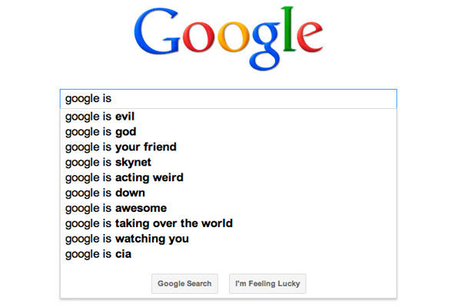
Query Autocompletion
Query Auto Completion is a feature, in which an application predicts the rest of the word
user is typing.
Aim is to get best top n queries
for a given subquery.

Slide 6
Trie Data Structure
Trie is an efficient information retrieval data structure. The search complexity of trie could be brought to O(k), where k is the key length.
However, the penalty that trie pays is its large storage requirements. Every node has 26 child nodes.

Slide 7
Why Trie Data Sructure?
Searching trees in general favor keys which are of fixed size since this leads to efficient storage management.
• However in case of applications which are retrieval based and which call for keys varying length, tries provide better options.
• Tries are also called as Lexicographic Search trees.
• The name trie (pronounced as “try”)originated from the word “retrieval”.

Slide 8
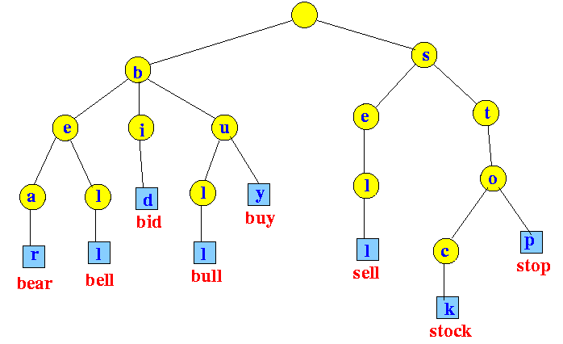
Structure of an Trie

Slide 9
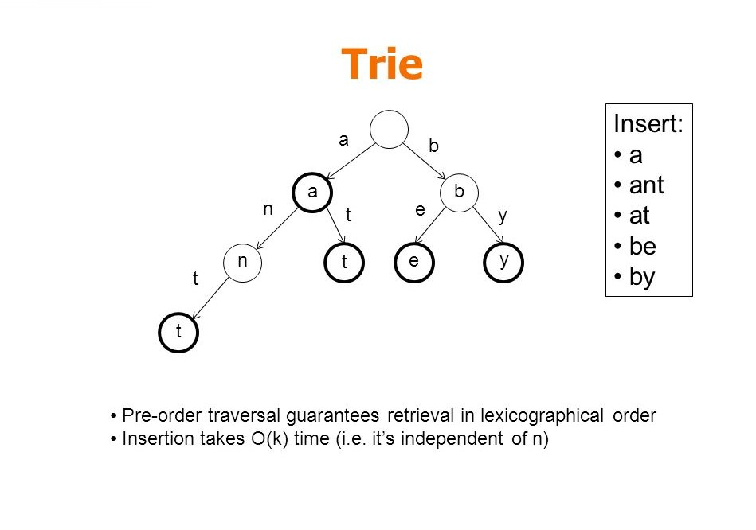
Insertion in Trie Data Structure

Slide 10
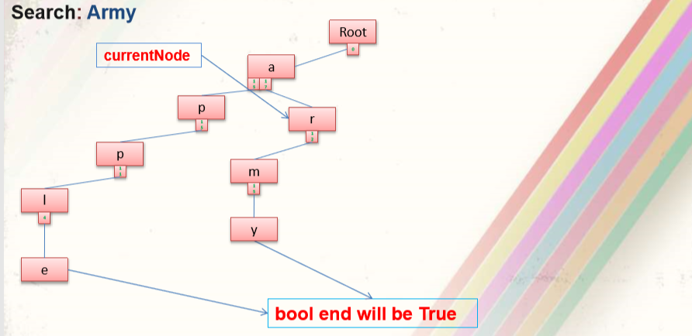
Searching for a key in Trie Data Structure

Slide 11
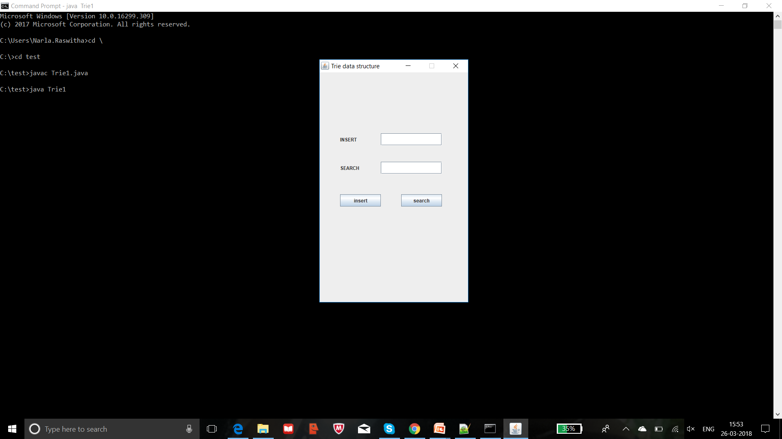

Slide 12
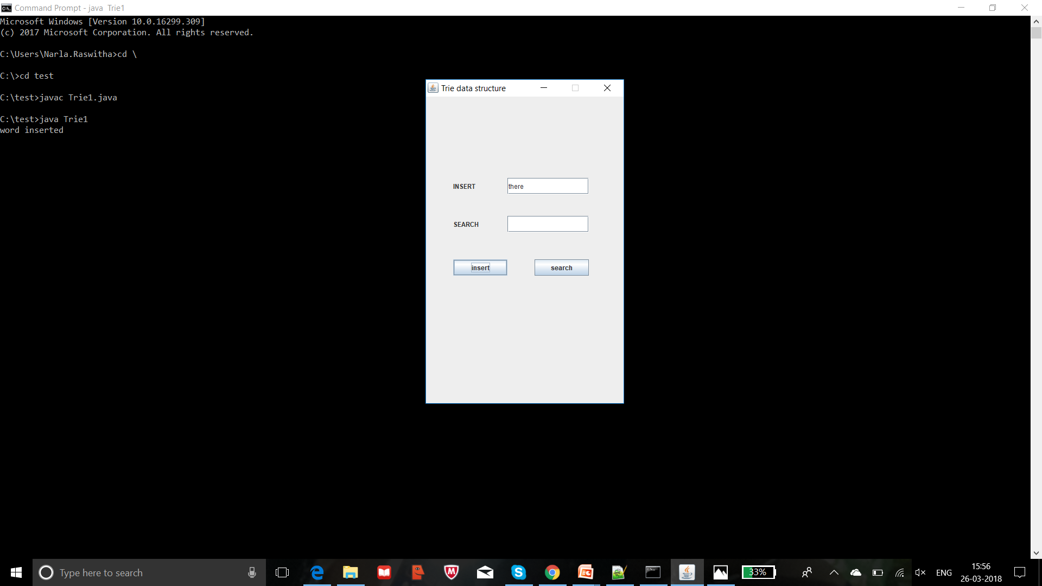

Slide 13
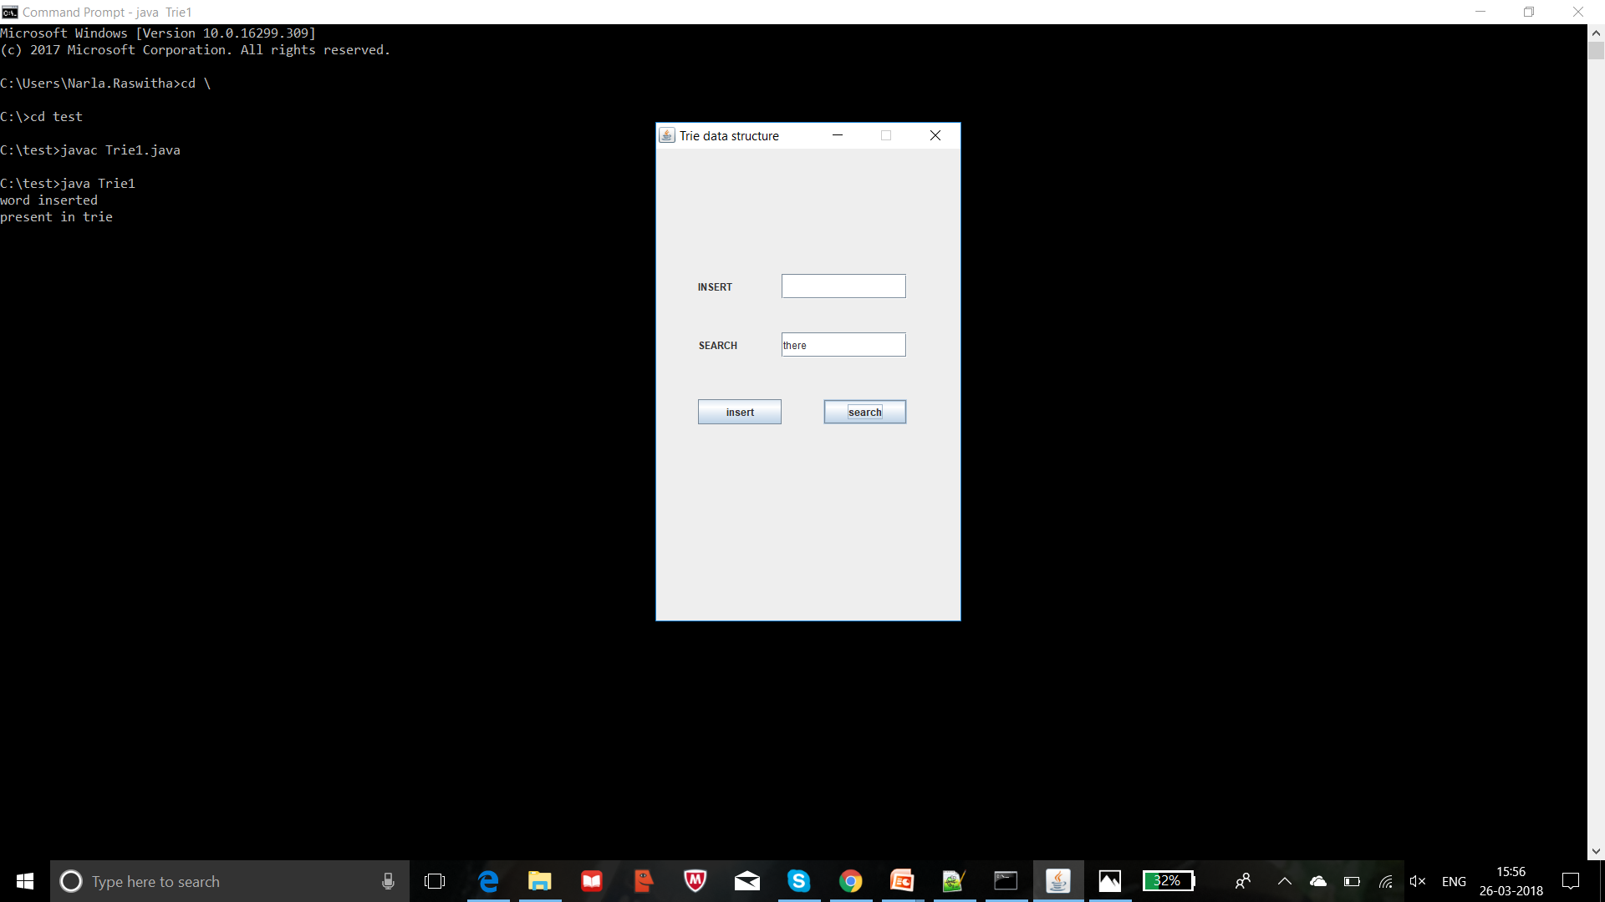

Slide 14
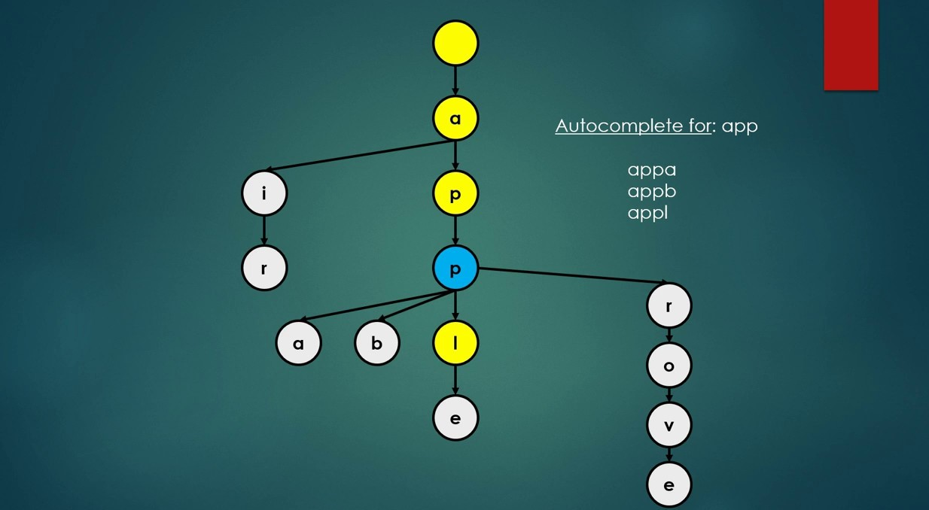
Auto Complete feature using Trie

Slide 15
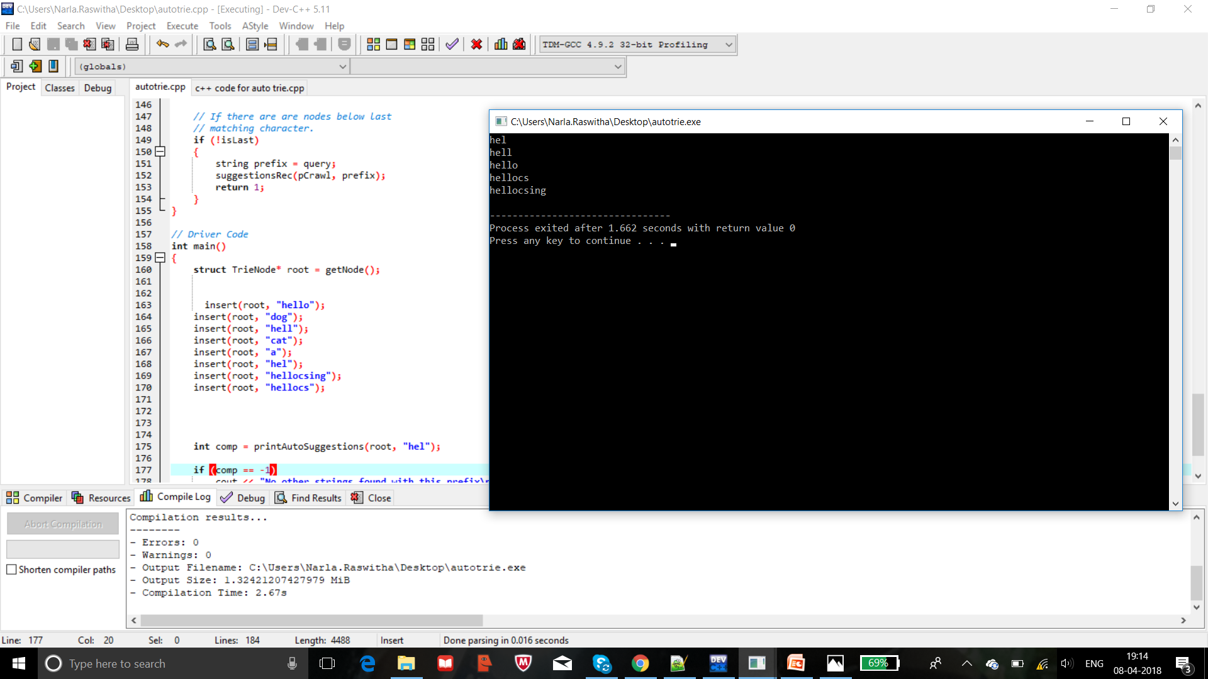

Slide 16


